Slide 1
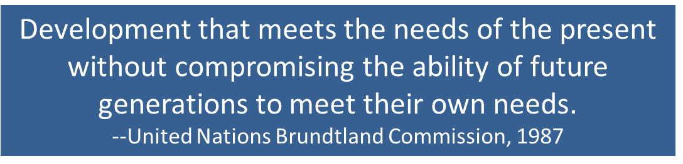

Slide 2
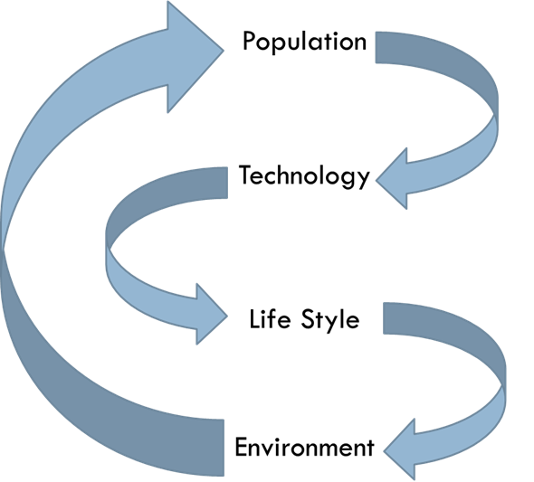

Slide 3
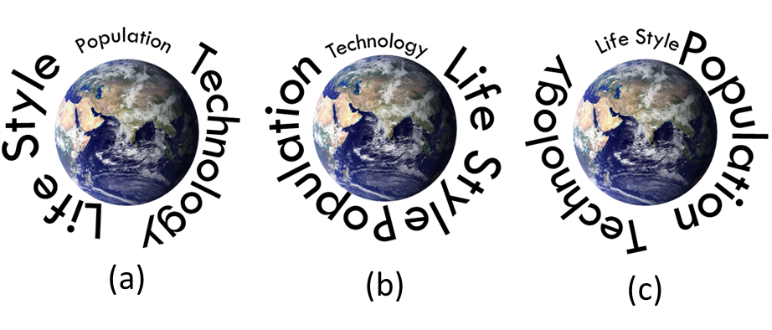
Three Extremes

Slide 4
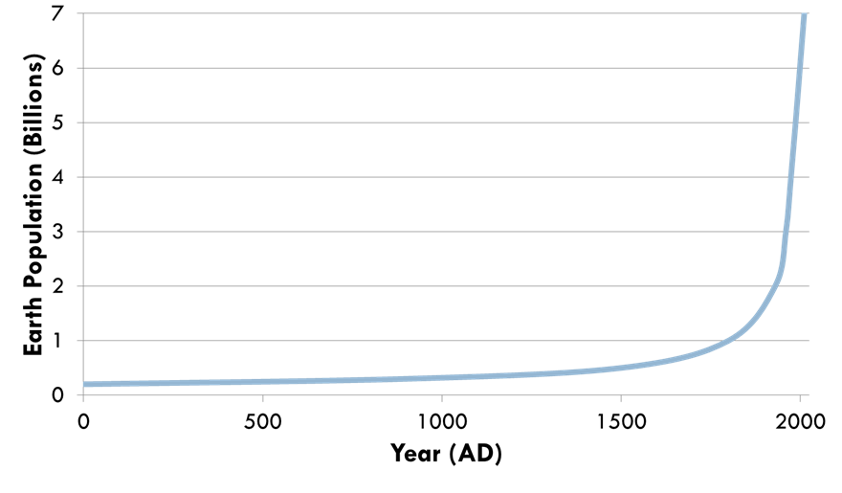
Population

Slide 5
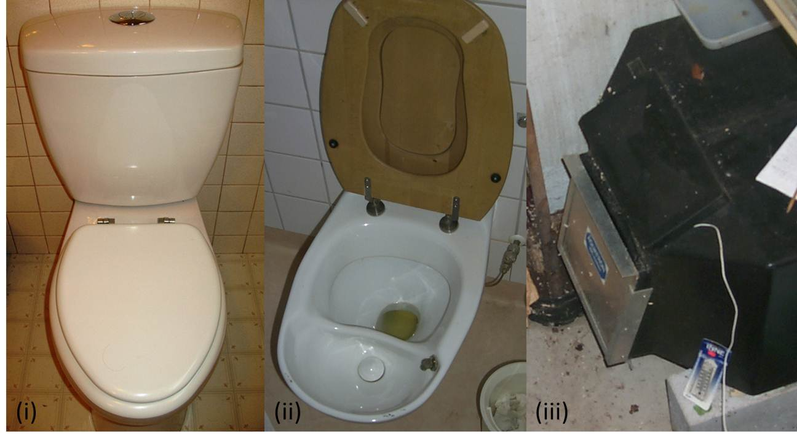
Technology

Slide 6

Technology

Slide 7
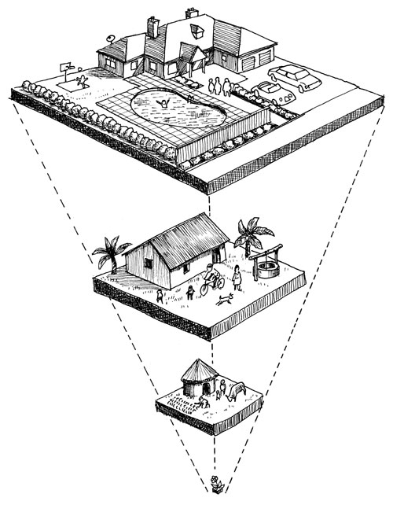
Life Style
candobetter.net

Slide 8
Environmental Engineering Ethics
World Federation of Engineering Organizations (WFEO):
Obtain a superior technical achievement, contribute to and promote a healthy and agreeable surrounding for all people, in open spaces as well as indoors;
Lowest possible consumption of raw materials and energy and the lowest production of wastes and any kind of pollution;
Discuss consequences of proposals and actions, direct or indirect, immediate or long term, upon the health of people, social equity and the local system of values;
Study environment that will be affected, assess all the impacts that might arise in the structure, dynamics and aesthetics of the ecosystems involved, urbanized or natural, as well as in the pertinent socioeconomic systems, and select the best alternative for development that is both environmentally sound and sustainable;
Understand and describe actions required to restore and improve environment that may be disturbed, and include in proposals;
Reject any commitment that involves unfair damages for human surroundings and nature, and aim for the best possible technical, social, and political solution;
Be aware that the principles of eco-systemic interdependence, diversity maintenance, resource recovery and inter-relational harmony form the basis of humankind’s continued existence and that each of these bases poses a threshold of sustainability that should not be exceeded.
www.wfeo.net

Slide 9
Human Needs & Related Engineering Disciplines
Need | Engineering Discipline
Water
Food
Clothing
Shelter
Transportation
Health
Waste Assimilation
Security

Slide 10
Triple Bottom Line

